Slide 1
Hinrich Schütze and Christina Lioma
Lecture 13: Text Classification & Naive Bayes

Slide 2
Overview
Recap
Text classification
Naive Bayes
NB theory
Evaluation of TC

Slide 3
Overview
Recap
Text classification
Naive Bayes
NB theory
Evaluation of TC

Slide 4
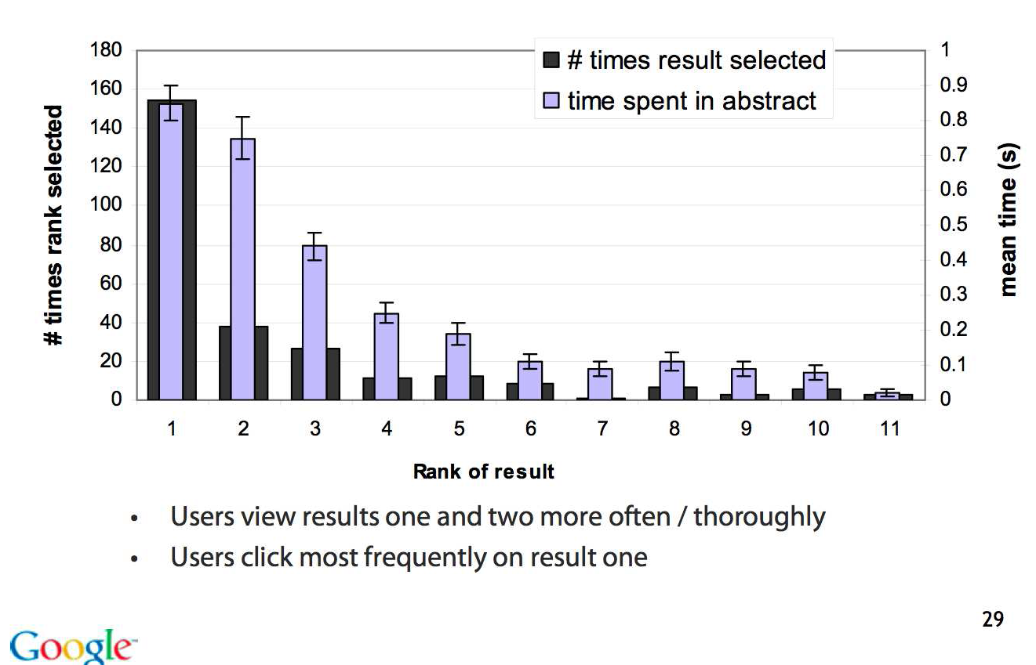
Looking vs. Clicking
4

Slide 5
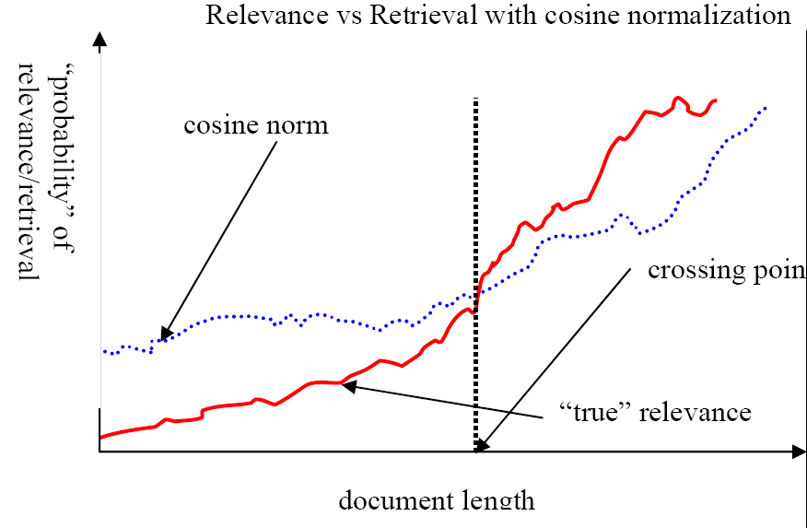
Pivot normalization
Source:
Lillian Lee
5

Slide 6
Use min heap for selecting top k out of N
Use a binary min heap
A binary min heap is a binary tree in which each node’s value is less than the values of its children.
It takes O(N log k) operations to construct the k-heap containing the k largest values (where N is the number of documents).
Essentially linear in N for small k and large N.
6

Slide 7
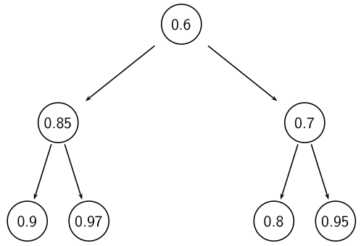
Binary min heap
7

Slide 8
Heuristics for finding the top k most relevant
Document-at-a-time processing
We complete computation of the query-document similarity score of document d_{i} before starting to compute the query-document similarity score of d_{i+1}.
Requires a consistent ordering of documents in the postings lists
Term-at-a-time processing
We complete processing the postings list of query term t_{i} before starting to process the postings list of t_{i+1}.
Requires an accumulator for each document “still in the running”
The most effective heuristics switch back and forth between term-at-a-time and document-at-a-time processing.
8

Slide 9
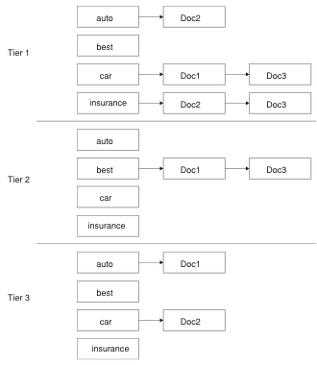
Tiered index
9

Slide 10
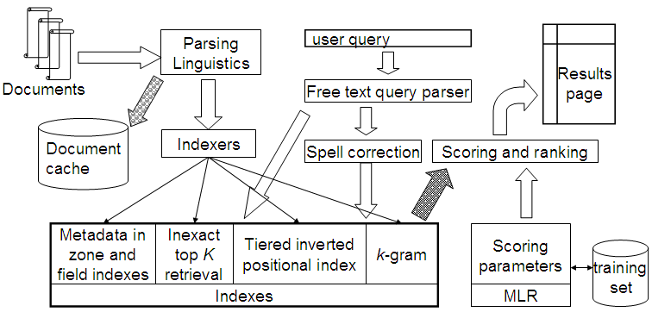
Complete search system
10

Slide 11
Take-away today
Text classification: definition & relevance to information retrieval
Naive Bayes: simple baseline text classifier
Theory: derivation of Naive Bayes classification rule & analysis
Evaluation of text classification: how do we know it worked / didn’t work?
11

Slide 12
Outline
Recap
Text classification
Naive Bayes
NB theory
Evaluation of TC

Slide 13
A text classification task: Email spam filtering
From: ‘‘’’ <takworlld@hotmail.com>
Subject: real estate is the only way... gem oalvgkay
Anyone can buy real estate with no money down
Stop paying rent TODAY !
There is no need to spend hundreds or even thousands for similar courses
I am 22 years old and I have already purchased 6 properties using the
methods outlined in this truly INCREDIBLE ebook.
Change your life NOW !
=================================================
Click Below to order:
http://www.wholesaledaily.com/sales/nmd.htm
=================================================
How would you write a program that would automatically detect
and delete this type of message?
13

Slide 14
Formal definition of TC: Training
Given:
A document space X
Documents are represented in this space – typically some type of high-dimensional space.
A fixed set of classes C = {c₁, c₂, . . . , c_{J}}
The classes are human-defined for the needs of an application (e.g., relevant vs. nonrelevant).
A training set D of labeled documents with each labeled document <d, c> ∈ X × C
Using a learning method or learning algorithm, we then wish to
learn a classifier ϒ that maps documents to classes:
ϒ : X → C
14

Slide 15
Formal definition of TC: Application/Testing
Given: a description d ∈ X of a document Determine: ϒ (d) ∈ C,
that is, the class that is most appropriate for d
15

Slide 16
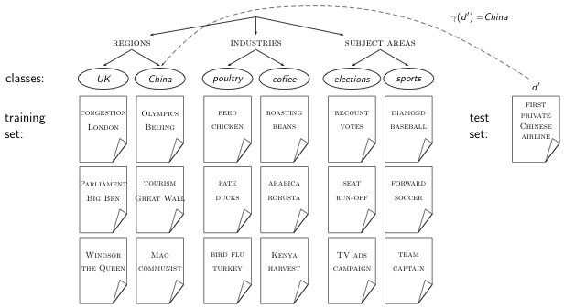
Topic classification
16

Slide 17
Exercise
Find examples of uses of text classification in information retrieval
17

Slide 18
Examples of how search engines use classification
Language identification (classes: English vs. French etc.)
The automatic detection of spam pages (spam vs. nonspam)
The automatic detection of sexually explicit content (sexually explicit vs. not)
Topic-specific or vertical search – restrict search to a “vertical” like “related to health” (relevant to vertical vs. not)
Standing queries (e.g., Google Alerts)
Sentiment detection: is a movie or product review positive or negative (positive vs. negative)
18

Slide 19
Classification methods: 1. Manual
Manual classification was used by Yahoo in the beginning of the web. Also: ODP, PubMed
Very accurate if job is done by experts
Consistent when the problem size and team is small
Scaling manual classification is difficult and expensive.
→ We need automatic methods for classification.
19

Slide 20
Classification methods: 2. Rule-based
Our Google Alerts example was rule-based classification.
There are IDE-type development enviroments for writing very complex rules efficiently. (e.g., Verity)
Often: Boolean combinations (as in Google Alerts)
Accuracy is very high if a rule has been carefully refined over time by a subject expert.
Building and maintaining rule-based classification systems is cumbersome and expensive.
20

Slide 21
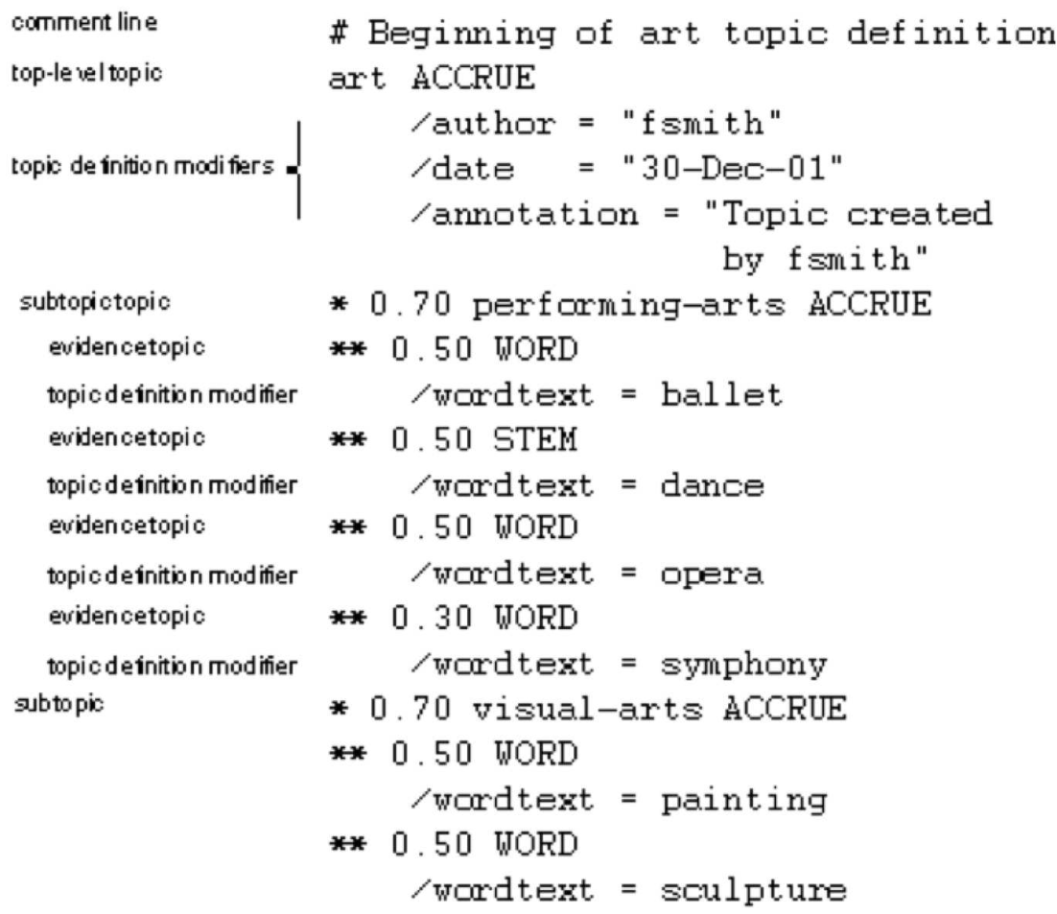
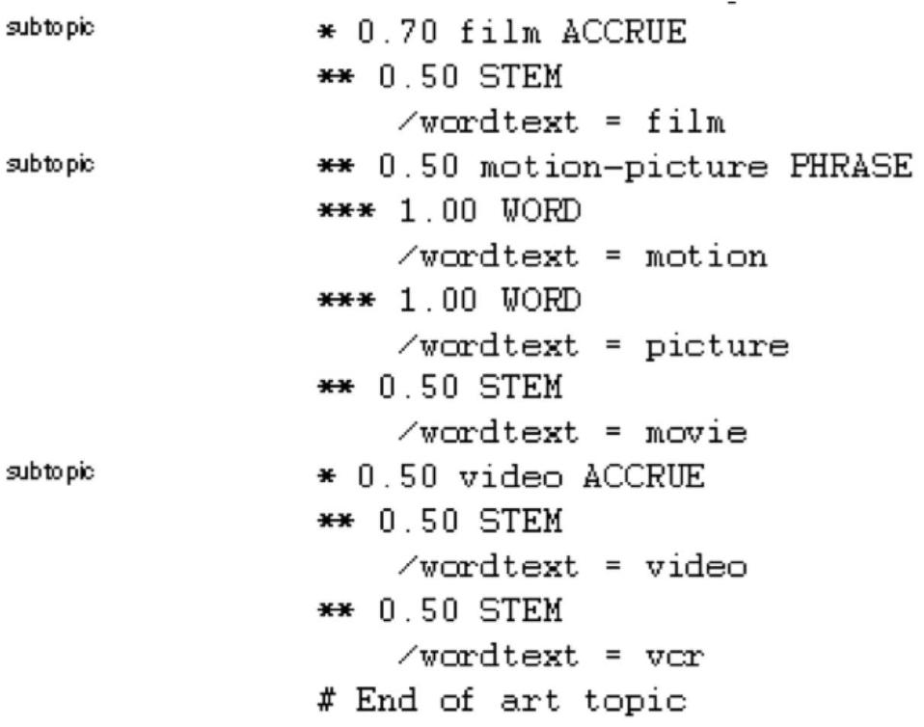
A Verity topic (a complex classification rule)
21

Slide 22
Classification methods: 3. Statistical/Probabilistic
This was our definition of the classification problem – text classification as a learning problem
(i) Supervised learning of a the classification function ϒ and
(ii) its application to classifying new documents
We will look at a couple of methods for doing this: Naive Bayes, Rocchio, kNN, SVMs
No free lunch: requires hand-classified training data
But this manual classification can be done by non-experts.
22

Slide 23
Outline
Recap
Text classification
Naive Bayes
NB theory
Evaluation of TC

Slide 24

The Naive Bayes classifier
The Naive Bayes classifier is a probabilistic classifier.
We compute the probability of a document d being in a class c
as follows:
n_{d} is the length of the document. (number of tokens)
P(t_{k} |c) is the conditional probability of term t_{k} occurring in a
document of class c
P(t_{k} |c) as a measure of how much evidence t_{k} contributes
that c is the correct class.
P(c) is the prior probability of c.
If a document’s terms do not provide clear evidence for one
class vs. another, we choose the c with highest P(c).
24

Slide 25

Maximum a posteriori class
Our goal in Naive Bayes classification is to find the “best” class.
The best class is the most likely or maximum a posteriori (MAP) class cmap:
25

Slide 26

Taking the log
Multiplying lots of small probabilities can result in floating point underflow.
Since log(xy) = log(x) + log(y), we can sum log probabilities instead of multiplying probabilities.
Since log is a monotonic function, the class with the highest score does not change.
So what we usually compute in practice is:
26

Slide 27

Naive Bayes classifier
Classification rule:
Simple interpretation:
Each conditional parameter log is a weight that indicates how good an indicator t_{k} is for c.
The prior log is a weight that indicates the relative frequency of c.
The sum of log prior and term weights is then a measure of how much evidence there is for the document being in the class.
We select the class with the most evidence.
27

Slide 28



Parameter estimation take 1: Maximum likelihood
Estimate parameters and from train data: How?
Prior:
N_{c} : number of docs in class c; N: total number of docs
Conditional probabilities:
T_{ct} is the number of tokens of t in training documents from class c (includes multiple occurrences)
We’ve made a Naive Bayes independence assumption here:
28

Slide 29
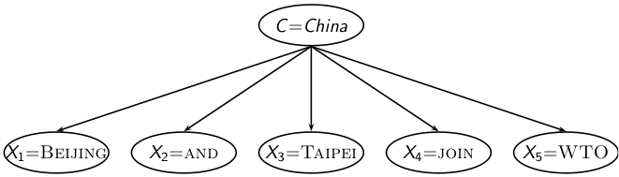

The problem with maximum likelihood estimates: Zeros
P(China|d) ∝ P(China) ・ P(BEIJING|China) ・ P(AND|China)
・ P(TAIPEI|China) ・ P(JOIN|China) ・ P(WTO|China)
If WTO never occurs in class China in the train set:
29

Slide 30

The problem with maximum likelihood estimates: Zeros
(cont)
If there were no occurrences of WTO in documents in class China, we’d get a zero estimate:
→ We will get P(China|d) = 0 for any document that contains WTO!
Zero probabilities cannot be conditioned away.
30

Slide 31


To avoid zeros: Add-one smoothing
Before:
Now: Add one to each count to avoid zeros:
B is the number of different words (in this case the size of the vocabulary: |V | = M)
31

Slide 32
To avoid zeros: Add-one smoothing
Estimate parameters from the training corpus using add-one smoothing
For a new document, for each class, compute sum of (i) log of prior and (ii) logs of conditional probabilities of the terms
Assign the document to the class with the largest score
32

Slide 33
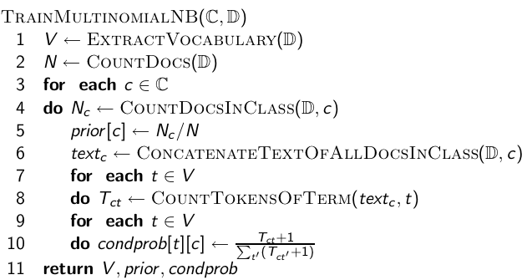
Naive Bayes: Training
33

Slide 34
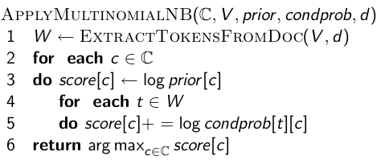
Naive Bayes: Testing
34

Slide 35
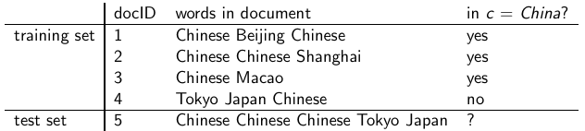
Exercise
Estimate parameters of Naive Bayes classifier
Classify test document
35

Slide 36
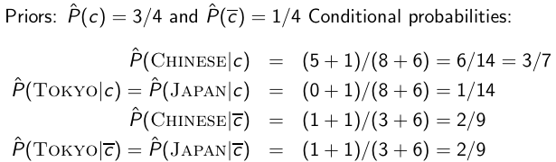
Example: Parameter estimates
The denominators are (8 + 6) and (3 + 6) because the lengths of
text_{c} and are 8 and 3, respectively, and because the constant
B is 6 as the vocabulary consists of six terms.
36

Slide 37

Example: Classification
Thus, the classifier assigns the test document to c = China. The
reason for this classification decision is that the three occurrences
of the positive indicator CHINESE in d₅ outweigh the occurrences
of the two negative indicators JAPAN and TOKYO.
37

Slide 38


Time complexity of Naive Bayes
L_{ave}: average length of a training doc, L_{a}: length of the test doc, M_{a}: number of distinct terms in the test doc, training set, V : vocabulary, set of classes
is the time it takes to compute all counts.
is the time it takes to compute the parameters from the counts.
Generally:
Test time is also linear (in the length of the test document).
Thus: Naive Bayes is linear in the size of the training set (training) and the test document (testing). This is optimal.
38

Slide 39
Outline
Recap
Text classification
Naive Bayes
NB theory
Evaluation of TC

Slide 40
Naive Bayes: Analysis
Now we want to gain a better understanding of the properties of Naive Bayes.
We will formally derive the classification rule . . .
. . . and state the assumptions we make in that derivation explicitly.
40

Slide 41




Derivation of Naive Bayes rule
We want to find the class that is most likely given the document:
Apply Bayes rule
Drop denominator since P(d) is the same for all classes:
41

Slide 42

Too many parameters / sparseness
There are too many parameters , one for each unique combination of a class and a sequence of words.
We would need a very, very large number of training examples to estimate that many parameters.
This is the problem of data sparseness.
42

Slide 43


Naive Bayes conditional independence assumption
To reduce the number of parameters to a manageable size, we
make the Naive Bayes conditional independence assumption:
We assume that the probability of observing the conjunction of
attributes is equal to the product of the individual probabilities
P(Xk = tk |c). Recall from earlier the estimates for these priors and
conditional probabilities:
43

Slide 44
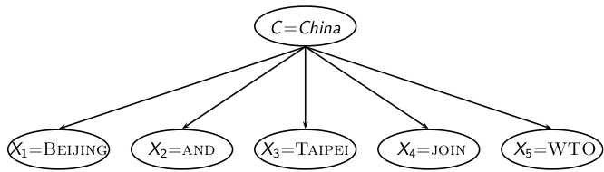

Generative model
Generate a class with probability P(c)
Generate each of the words (in their respective positions), conditional on the class, but independent of each other, with probability P(t_{k} |c)
To classify docs, we “reengineer” this process and find the class that is most likely to have generated the doc.
44

Slide 45

Second independence assumption
For example, for a document in the class UK, the probability of generating QUEEN in the first position of the document is the same as generating it in the last position.
The two independence assumptions amount to the bag of words model.
45

Slide 46
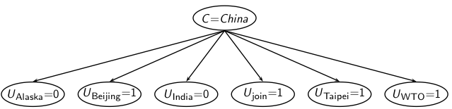
A different Naive Bayes model: Bernoulli model
46

Slide 47

Violation of Naive Bayes independence assumption
The independence assumptions do not really hold of documents written in natural language.
Conditional independence:
Positional independence:
Exercise
Examples for why conditional independence assumption is not really true?
Examples for why positional independence assumption is not really true?
How can Naive Bayes work if it makes such inappropriate assumptions?
47

Slide 48
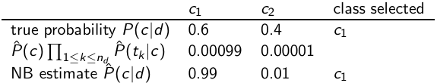
Why does Naive Bayes work?
Naive Bayes can work well even though conditional independence assumptions are badly violated.
Example:
Double counting of evidence causes underestimation (0.01) and overestimation (0.99).
Classification is about predicting the correct class and not about accurately estimating probabilities.
Correct estimation ⇒ accurate prediction.
But not vice versa!
48

Slide 49
Naive Bayes is not so naive
Naive Naive Bayes has won some bakeoffs (e.g., KDD-CUP 97)
More robust to nonrelevant features than some more complex learning methods
More robust to concept drift (changing of definition of class over time) than some more complex learning methods
Better than methods like decision trees when we have many equally important features
A good dependable baseline for text classification (but not the best)
Optimal if independence assumptions hold (never true for text, but true for some domains)
Very fast
Low storage requirements
49

Slide 50
Outline
Recap
Text classification
Naive Bayes
NB theory
Evaluation of TC

Slide 51
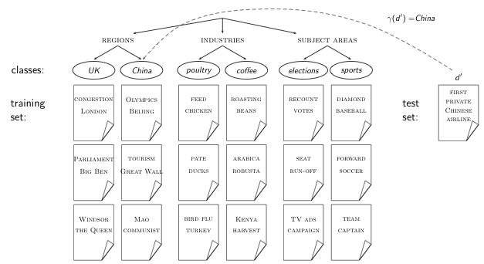
Evaluation on Reuters
51

Slide 52
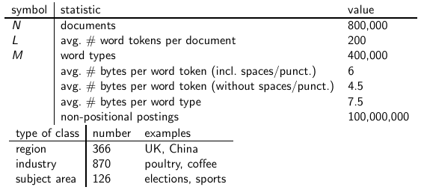
Example: The Reuters collection
52

Slide 53

A Reuters document
53

Slide 54
Evaluating classification
Evaluation must be done on test data that are independent of the training data (usually a disjoint set of instances).
It’s easy to get good performance on a test set that was available to the learner during training (e.g., just memorize the test set).
Measures: Precision, recall, F₁, classification accuracy
54

Slide 55

Precision P and recall R
P = TP / ( TP + FP)
R = TP / ( TP + FN)
55

Slide 56


A combined measure: F
F1 allows us to trade off precision against recall.
This is the harmonic mean of P and R:
56

Slide 57
Averaging: Micro vs. Macro
We now have an evaluation measure (F₁) for one class.
But we also want a single number that measures the aggregate performance over all classes in the collection.
Macroaveraging
Compute F₁ for each of the C classes
Average these C numbers
Microaveraging
Compute TP, FP, FN for each of the C classes
Sum these C numbers (e.g., all TP to get aggregate TP)
Compute F₁ for aggregate TP, FP, FN
57

Slide 58
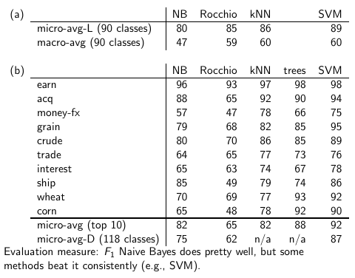
Naive Bayes vs. other methods
58

Slide 59
Take-away today
Text classification: definition & relevance to information retrieval
Naive Bayes: simple baseline text classifier
Theory: derivation of Naive Bayes classification rule & analysis
Evaluation of text classification: how do we know it worked / didn’t work?
59

Slide 60
Resources
Chapter 13 of IIR
Resources at http://ifnlp.org/ir
Weka: A data mining software package that includes an implementation of Naive Bayes
Reuters-21578 – the most famous text classification evaluation set (but now it’s too small for realistic experiments)
60

